Slide 1

Machine Learning Approaches for Effective Movie Recommendations: A Comprehensive Study
PRML PROJECT

Slide 2
Content
1) Introduction
2) Approaches Tried
3)Experiment
4) Results

Slide 3
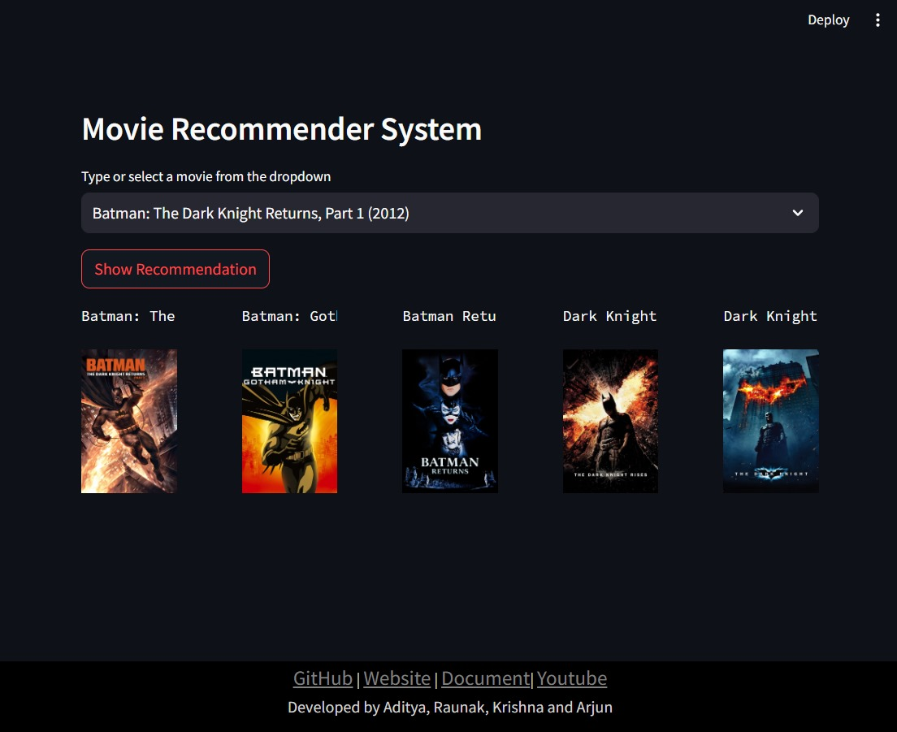
INTRODUCTION
In today's digital age, the vast array of available content can be overwhelming for individuals seeking entertainment options. From movies and TV shows to books and music, the abundance of choices often leads to decision fatigue and frustration.
In response to this challenge, recommendation systems have emerged as invaluable tools, designed to alleviate the burden of choice by offering personalized suggestions tailored to individual preferences and interests

Slide 4
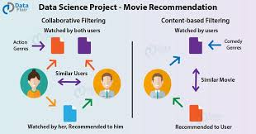
Approaches Tried Content-Based Filtering i) Jaccard Similarity ii) Cosine Similarity iii) K-Nearest Neighbors (KNN) Collaborative Filtering i) Deep Learning ii) K-Mean Clustering iii) Matrix Factorization Hybrid Filtering

Slide 5
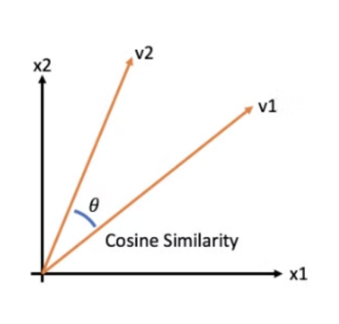
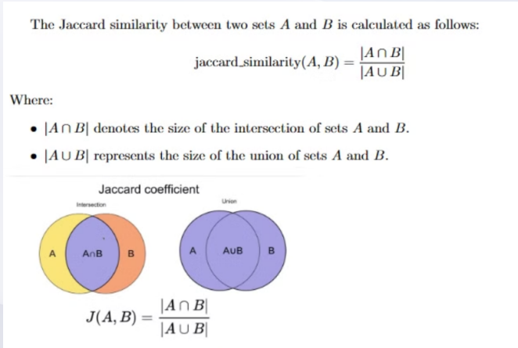
Content Based Filtering
A. Jaccard Similarity
Jaccard similarity is a metric used to measure the similarity between two sets by comparing their intersection to their union.
In movie recommendation systems, Jaccard similarity can be applied to compare sets of attributes associated with movies, such as genres, tags, or keywords.
B . Cosine Similarity
Cosine similarity is a metric used to measure the similarity between two vectors by calculating the cosine of the angle between them.

Slide 6
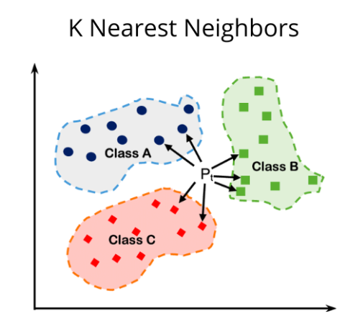
C . K-Nearest Neighbour (KNN)
K-Nearest Neighbors (KNN) is an algorithm used for recommendation by finding the k nearest neighbors of a given item based on a similarity metric.
In movie recommendation systems, KNN identifies the k movies most similar to those that a user has liked in the past. This is achieved by calculating the similarity between movies using metrics such as cosine similarity or Euclidean distance, and then recommending movies that are closest to the user's liked items

Slide 7
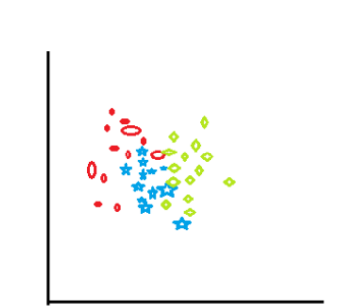
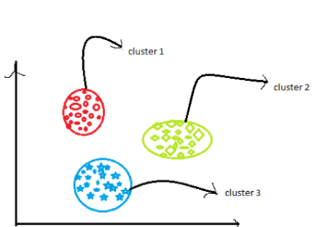
Collaborative Filtering
A. Deep Learning
Deep learning models, such as neural networks, can be used for collaborative filtering by learning complex patterns in user item interactions from the data. They can capture nonlinear relationships between users and item
B . K-Mean Clustering
K-Means clustering groups users or items into clusters based on their similarity. It can be used to segment users or items into groups with similar preferences, which can then be used for recommendation
Before applying k-mean clustering
After applying k-mean clustering

Slide 8
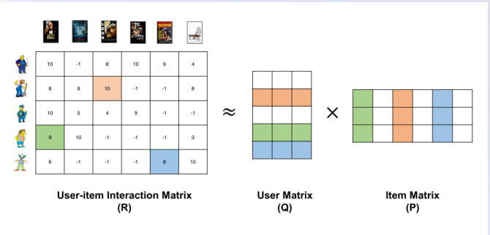
Collaborative Filtering
C. Matrix Factorization
Matrix factorization decomposes the user-item interaction matrix into two lower-dimensional matrices representing latent factors for users and items. It captures underlying patterns in the data and can make recommendations based on these latent factors

Slide 9
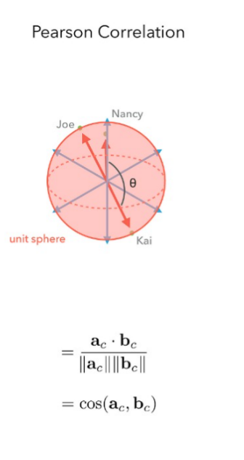
Collaborative Filtering
D. Nearest Neighbors
Nearest neighbors-based collaborative filtering recommends items to a user based on the preferences of similar users or items.
It finds users or items similar to the target user and recommends items liked by those similar users.
E. Pearson Similarity
Pearson correlation measures the linear correlation between two variables, such as the ratings given by users to different items.
In movie recommendation systems, Pearson similarity is used to find users with similar rating patterns and make recommendations based on their preferences.

Slide 10
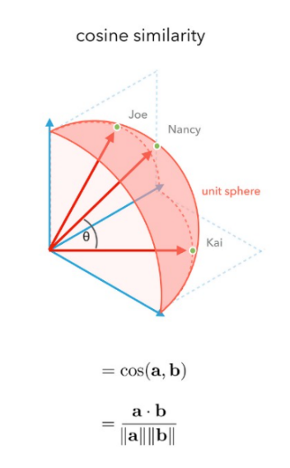
Hybrid Filtering
A. Cosine Similarity and Matrix Factorization
This hybrid model combines content-based filtering (cosine similarity) and collaborative filtering (matrix factorization).
It leverages both user-item interactions and item features to make recommendations, providing a more comprehensive approach to recommendation

Slide 11
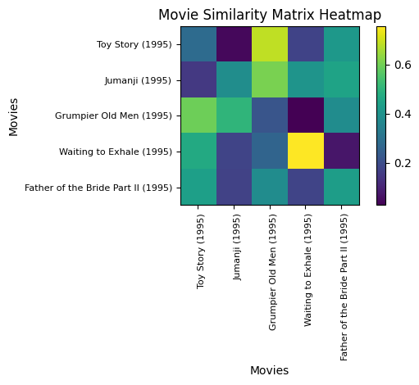
Learnings

Slide 12
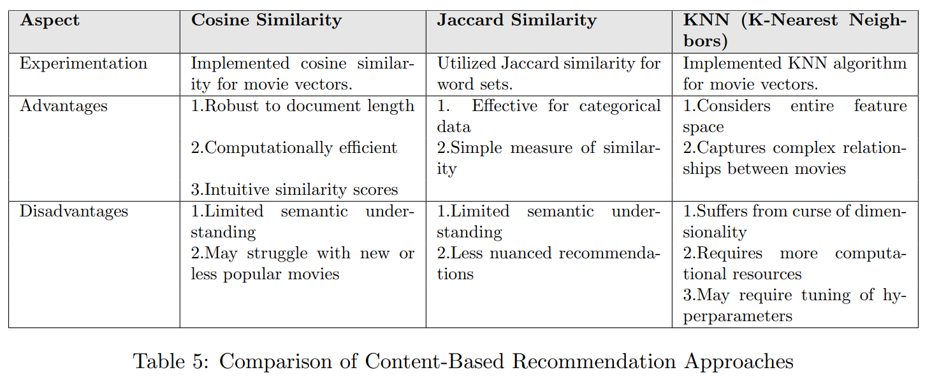
1) Content-Based Filtering :

Slide 13
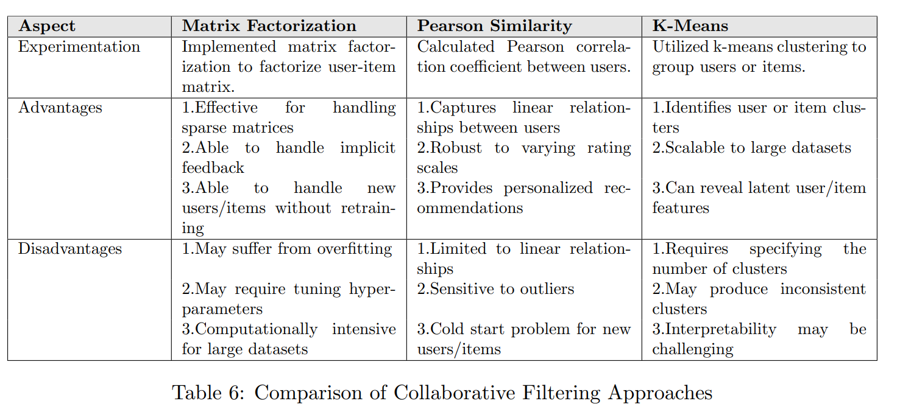
2) Collaborative Filtering

Slide 14
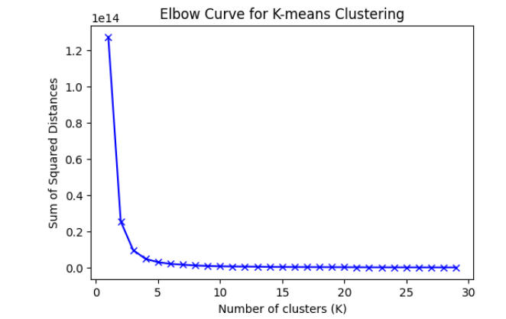
Hence, from the graph we can see that optimum number of neighbors = 15 - 20.

Slide 15
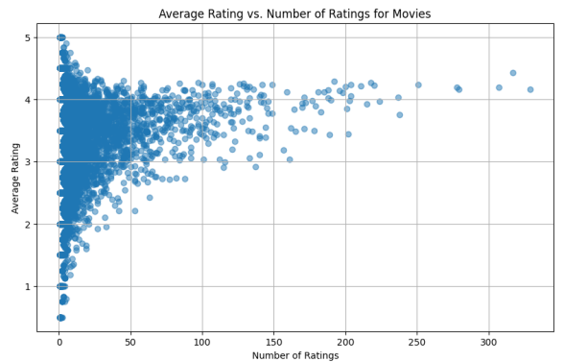
3) Hybrid Filtering :
A hybrid recommender system combines two or more recommendation techniques to create a more robust and flexible system.

Slide 16
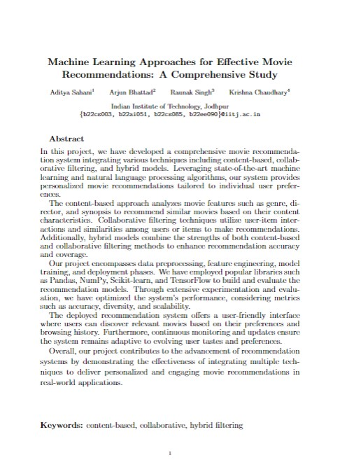
Major Findings

Slide 17
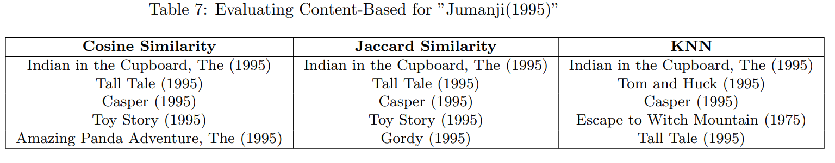
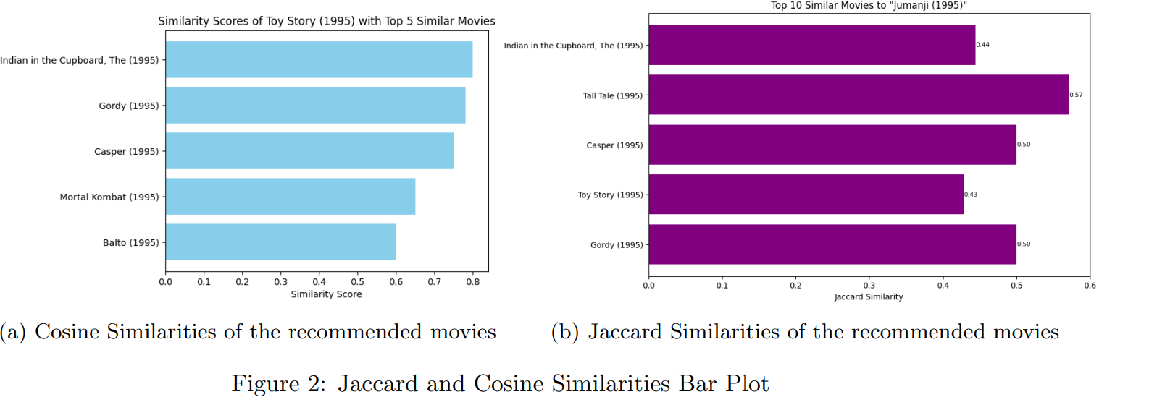
1) Content-Based Filtering :

Slide 18
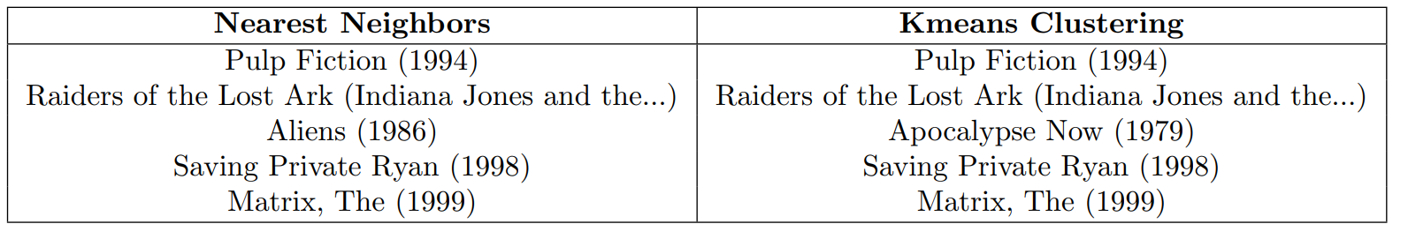
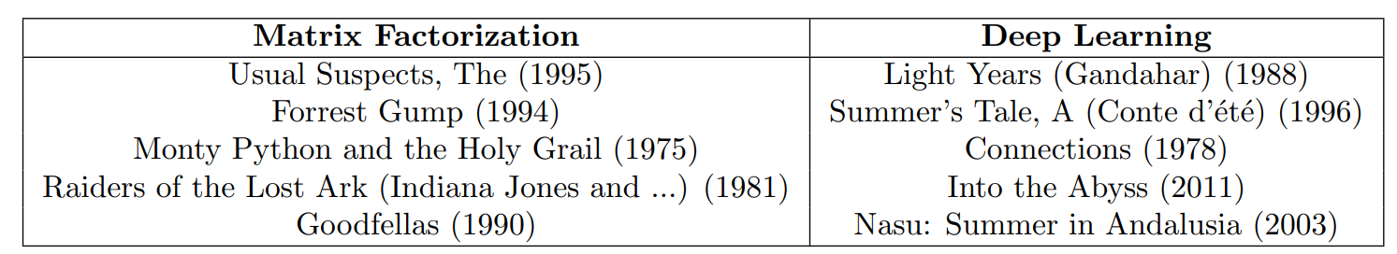
2) Collaborative-Based Filtering :
Nearest Neighbours vs K-Means
2. Matrix Factorization vs Deep Learning

Slide 19
SUMMARY
The project focused on building a movie recommendation system using machine learning techniques. It incorporated three content-based filtering models (Cosine Similarity, Jaccard Similarity, KNN) and five collaborative filtering models (Deep Learning, Kmeans Clustering, Matrix Factorization, Nearest Neighbors, Pearson Similarity).
Each model was evaluated for its performance in recommending relevant movies to users. By implementing these techniques, the project aimed to provide users with personalized movie recommendations based on their preferences and similarities with other users or movies.

Slide 20
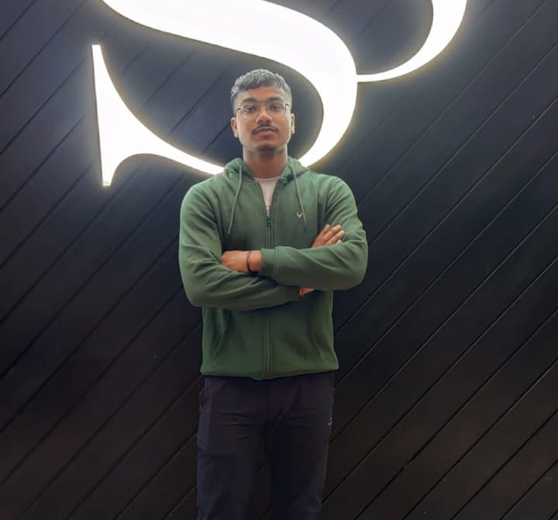


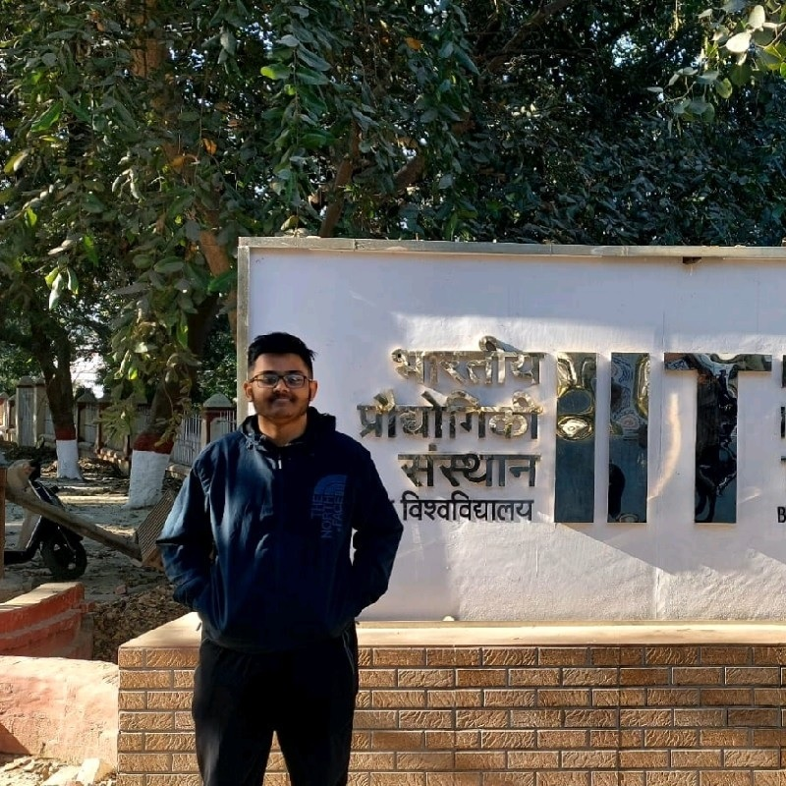
MEET OUR TEAM
Aditya Sahani
Krishna Chaudhary
Arjun Bhattad
Raunak Singh
B22CS003
B22EE090
B22AI051
B22CS085

Slide 21
Contribution of Each Member
Aditya Sahani
Focused on implementing deep learning models and matrix factorization techniques for the recommendation system.
Contributed to the development and maintenance of the demo website.
Raunak Singh
Worked on implementing the KMeans clustering algorithm and the kNN algorithm.
Contributed to developing and maintaining the course website and creating a spotlight video.
Arjun Bhattad
Implemented Jaccard similarity and Pearson similarity calculations, and contributed to the nearest neighbors algorithm.
Ensured accurate documentation and communication of methodologies and results.
Krishna Chaudhary
Implemented cosine similarity calculations and contributed to data preprocessing
Helped in drafting the project report and consolidating the finding

Slide 22
THANK YOU

